Slide 1
VesPA SoC
Embedded Systems
A Pipeline Approach
Notes:
Mário

Slide 2
Agenda
CPU
Design
Pipelined Datapath
Control Unit
Hazard Unit
Bus
Implementation
Pipelined Datapath
Control Unit
Hazard Unit
Bus
Verification
Peripherals
Interrupt Controller
GPIO
Timer
UART
PS2
VGA

Slide 3
CPU DESIGN

Slide 4
CPU Design
Pipelined Datapath
Pipeline Stages:
Instruction Fetch
Instruction Decode
Instruction Execution
Data Memory Access
Write Back
Intermediate Register Files:
Fetch to Decode Register File
Decode to Execute Register File
Execute to Memory Register File
Memory to Write-Back Register File
Notes:
Mário

Slide 5
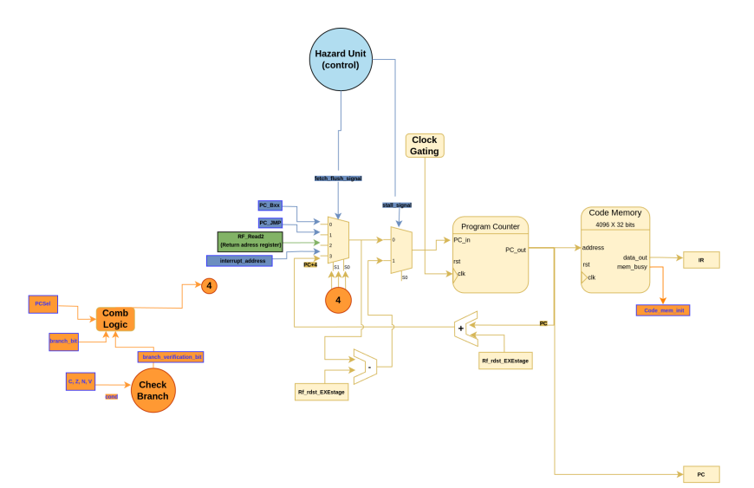
CPU Design
Fetch Stage
Load the instruction into the register corresponding program counter.
Notes:
Luiz

Slide 6
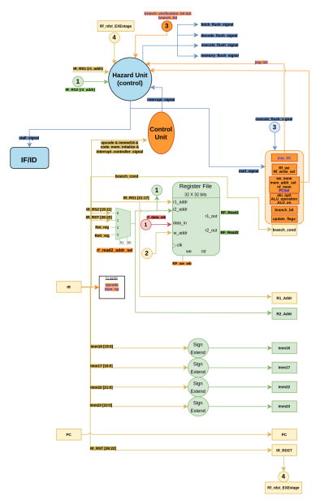
CPU Design
Decode Stage
Decodes Instruction
Generate signals from control unit
Hazard Unit
Data hazards
Control hazards
Register File
32 registers
3 ports
Signal Extension
Notes:
Luiz

Slide 7
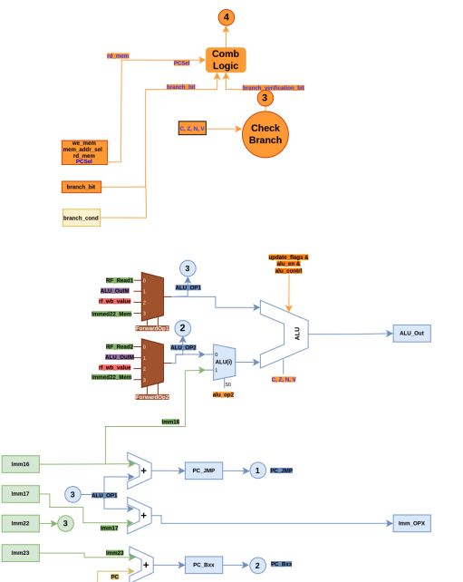
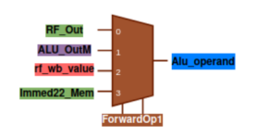
CPU Design
Execute Stage
ALU
Branch checking
Addresses calculation
Branches
Jumps
Forward multiplexers
Notes:
Luiz

Slide 8
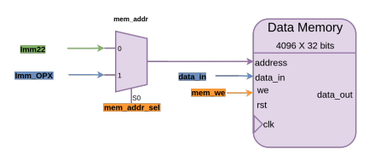
CPU Design
Memory Stage
Address Selector
Immediate
Indexed
Data Memory
Notes:
Luiz

Slide 9
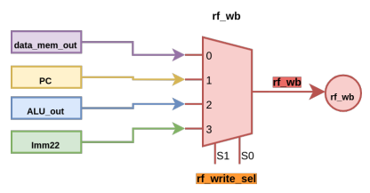
CPU Design
Write Back Stage
Register file write selector
Memory output
Jump link (save PC)
ALU output
Immediate value (LDI)
Notes:
Luiz

Slide 10
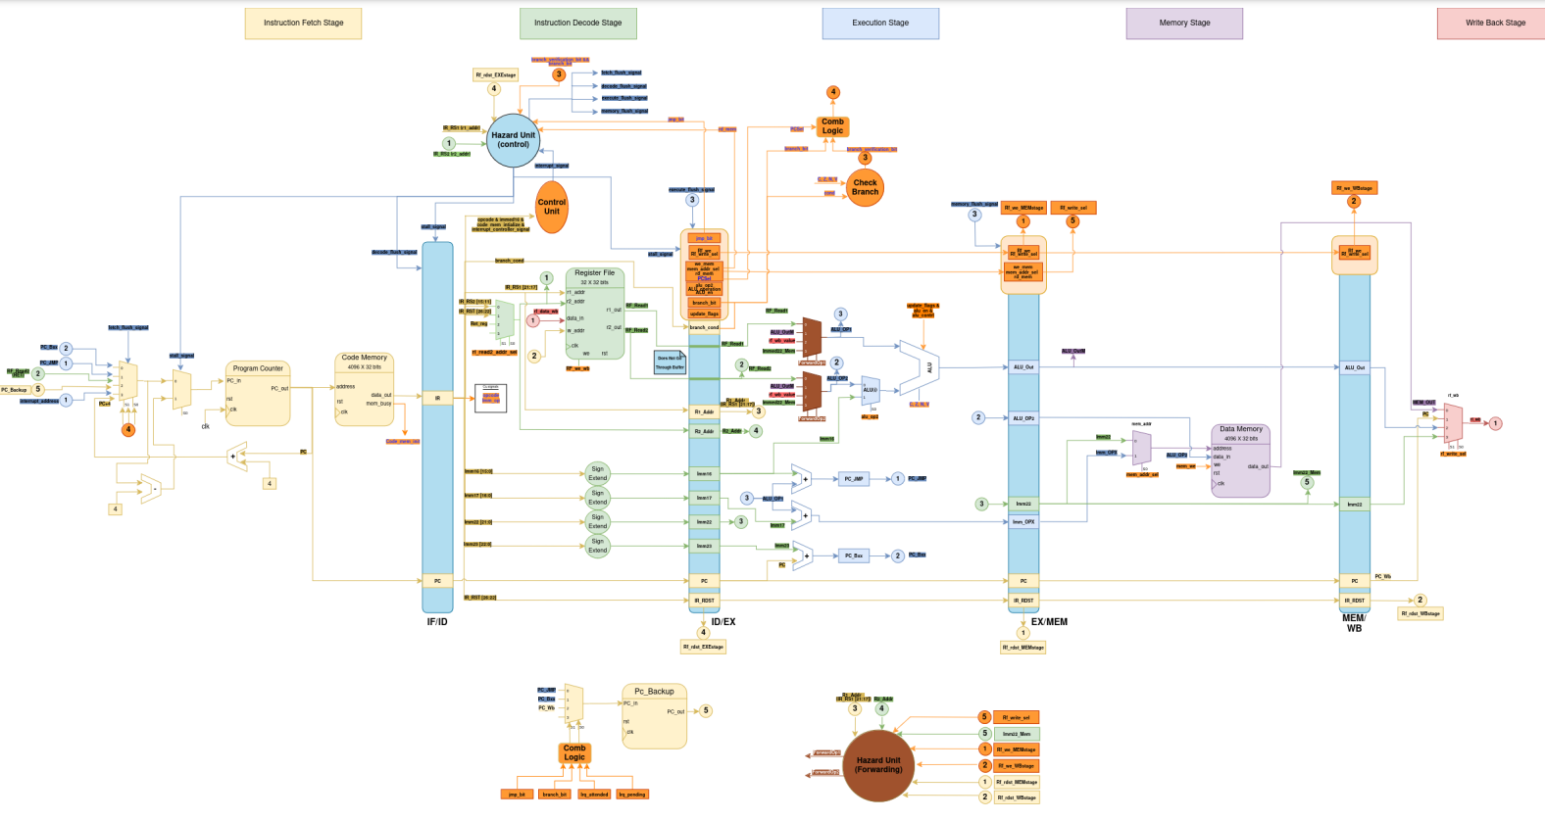
CPU Design
Overview
Notes:
Luiz - Dizer aqui que estão os registos intermediários e explicar a cena de a saída da memória passar à frente o register file intermédio

Slide 11
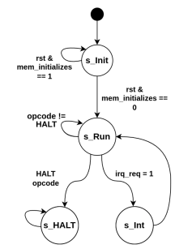
CPU Design
Control Unit
STATE MACHINE
Notes:
Luiz

Slide 12
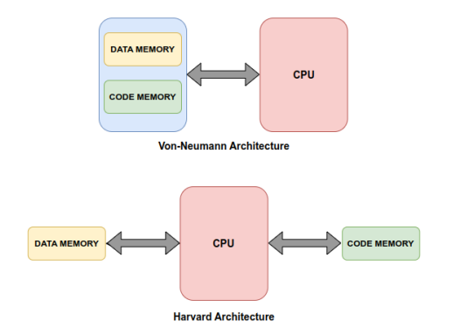
CPU Design
Hazard Unit
Structural Hazard Mitigation
CPU Architecture Alteration
Notes:
Mário/Alfredo

Slide 13
CPU Design
Hazard Unit
Data hazards:
In case of a LOAD instruction before a Register file access instruction, asking for the same register, the solution is:
Stall the pipeline during one cycle due the memory latency.
If an instruction uses the value of a register while its value is still in the memory or write-back stage, forwarding occurs
Control hazards:
In case of a JMP instruction
Automatically flushes pipeline
In case of a Bxx instruction
Static Branch prediction (always not taken)
In case the branch should be taken it must flush the pipeline
Notes:
Mário/Alfredo

Slide 14
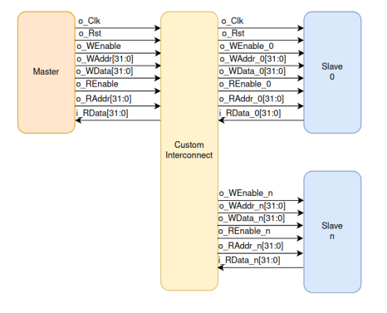
CPU Design
Bus
No read and write latency
Notes:
Mário / Alfredo

Slide 15
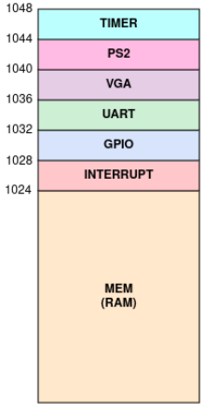
CPU Design
Memory Mapping
Notes:
Marcelo

Slide 16
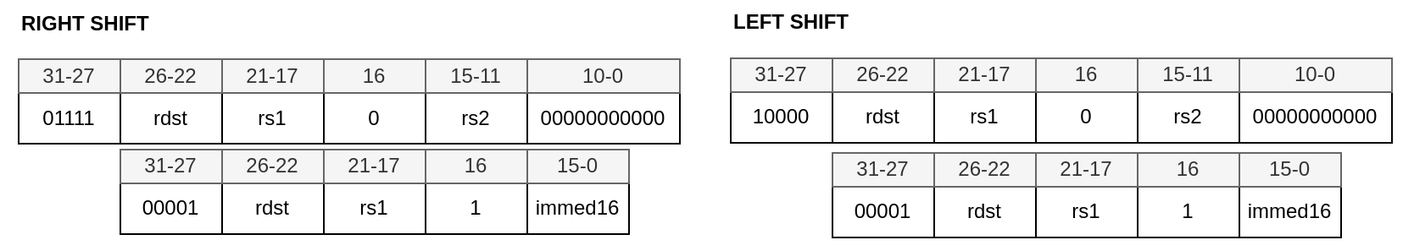
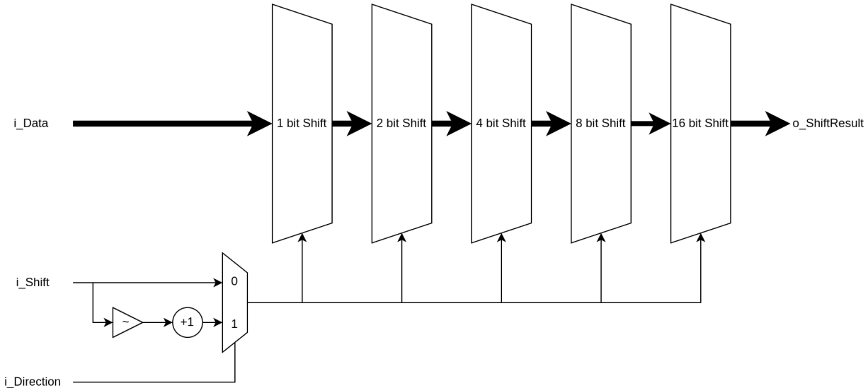
CPU Design
Barrel Shifter
Notes:
Marcelo

Slide 17
CPU IMPLEMENTATION

Slide 18
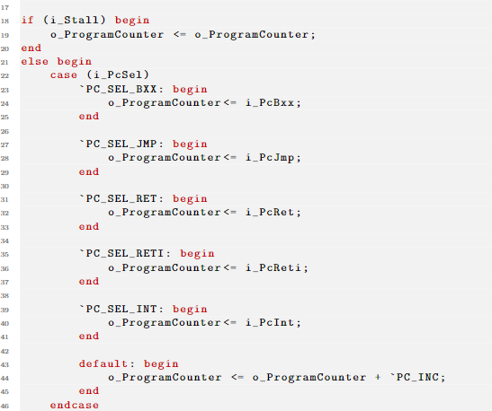
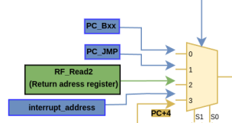
CPU Implementation
Fetch Stage
Notes:
Manel

Slide 19
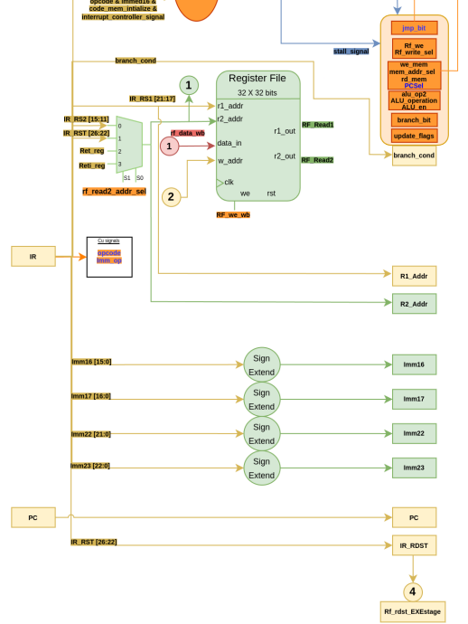
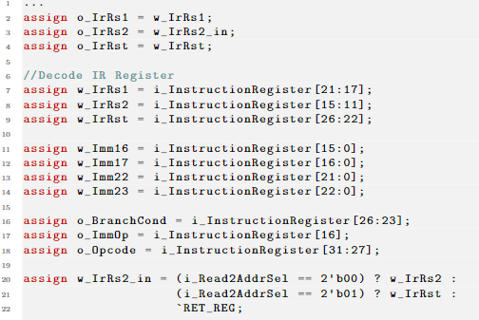
CPU Implementation
Decode Stage
Notes:
Manel

Slide 20
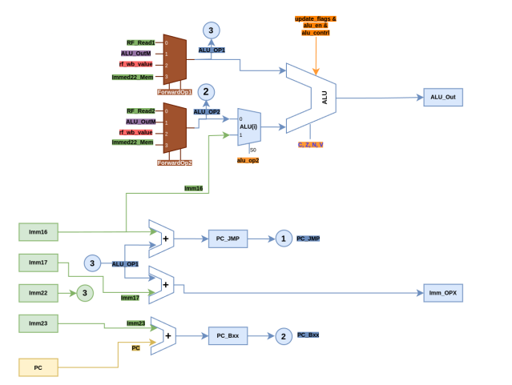
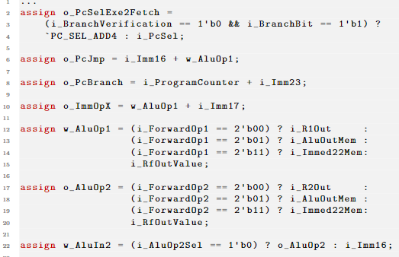
CPU Implementation
Execute Stage
Notes:
Manel

Slide 21
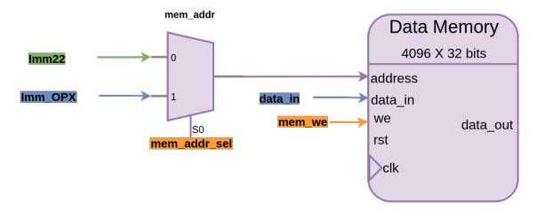

CPU Implementation
Memory Stage
Notes:
Manel

Slide 22
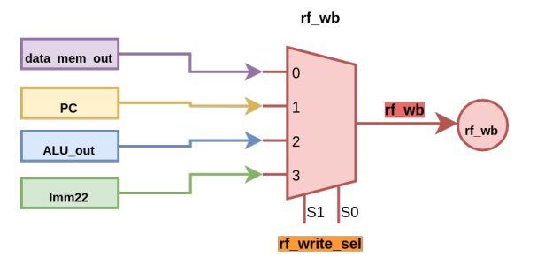
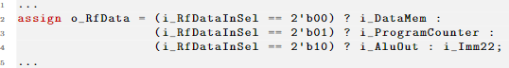
CPU Implementation
Write-Back Stage
Notes:
Marcelo

Slide 23
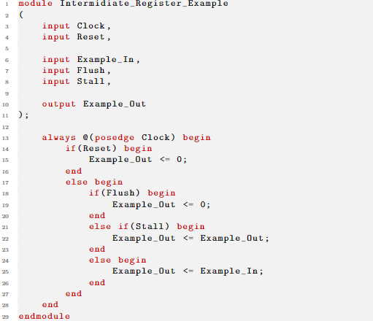
CPU Implementation
Intermediate Registers
Intermediate Register general representation
Notes:
Marcelo

Slide 24
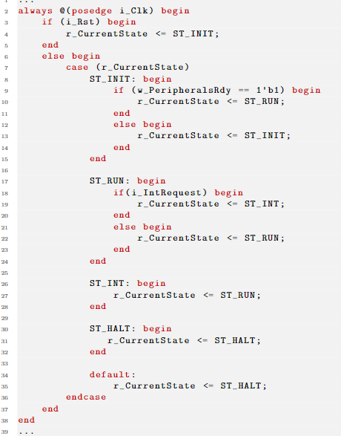
CPU Implementation
Control Unit
Notes:
Marcelo

Slide 25
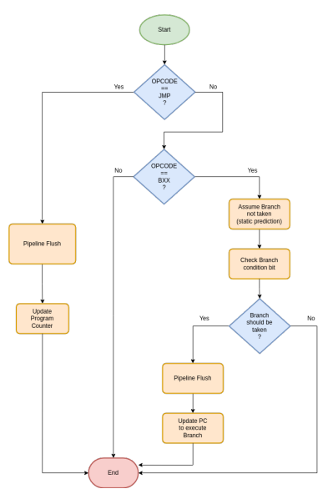
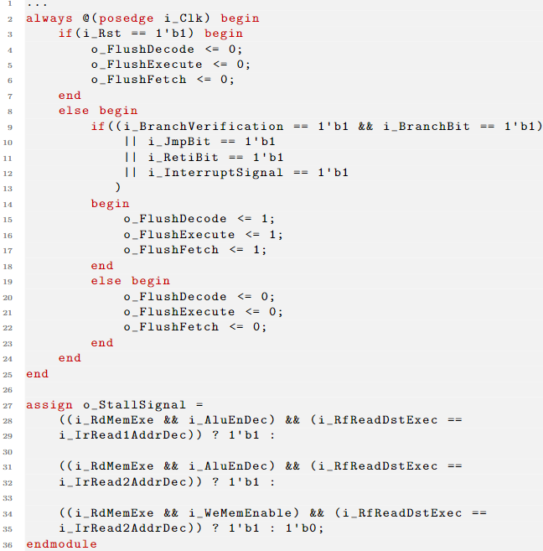
CPU Design
Hazard Unit
Control/Data
Notes:
Roberto

Slide 26
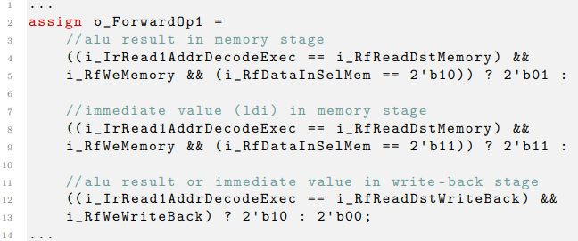
CPU Design
Forwarding Unit
Notes:
Roberto

Slide 27
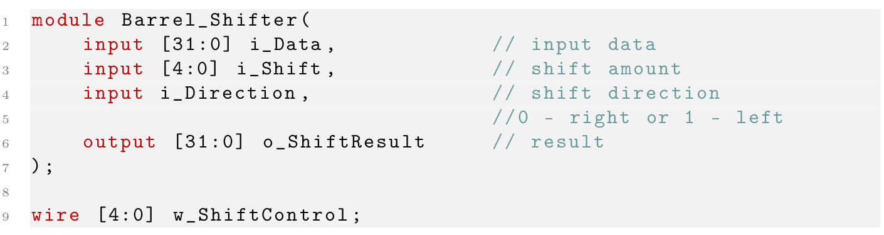
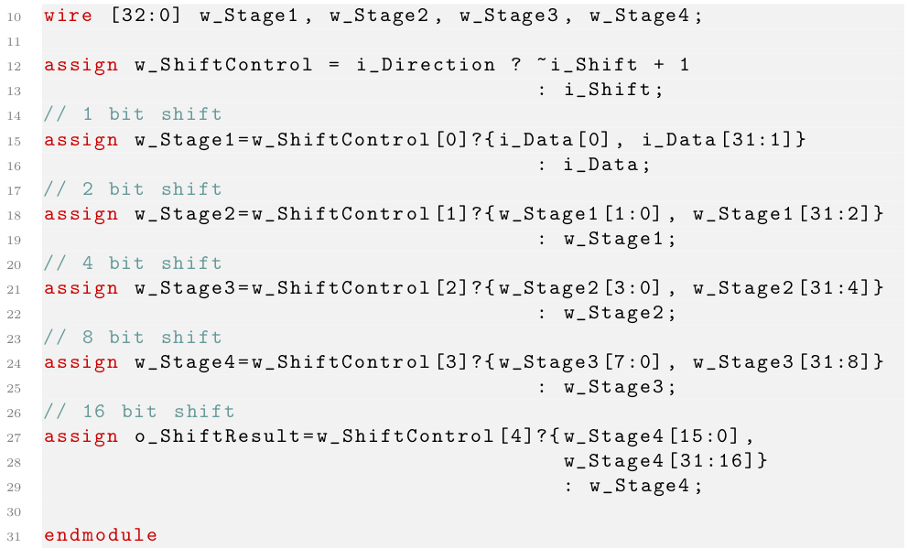
CPU Implementation
Barrel Shifter

Slide 28
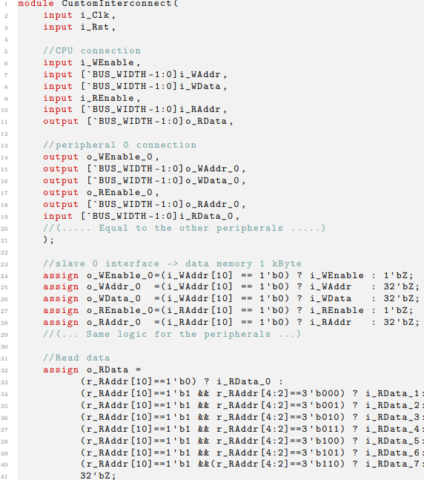
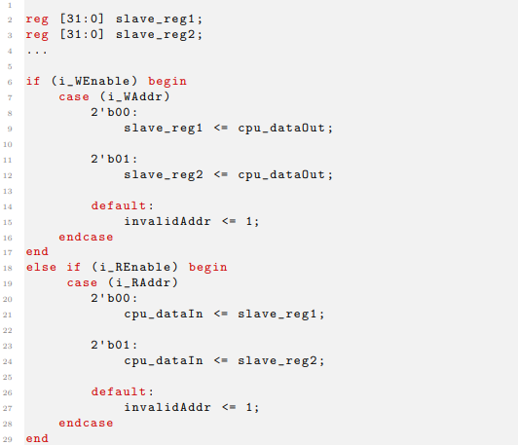
CPU Implementation
Bus
Interconnect
Slave Wrapper

Slide 29
CPU VERIFICATION

Slide 30
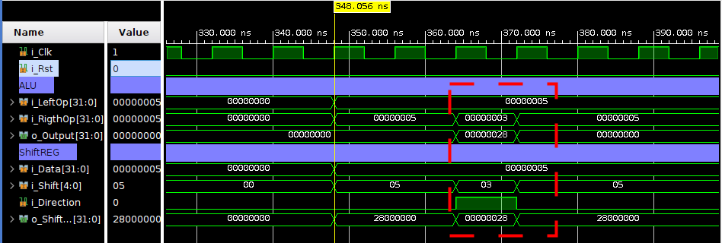
CPU Verification
Barrel Shifter
Value to be shifted = 5
Number of shifts = 3
Result = 28

Slide 31
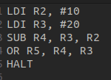
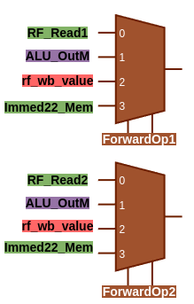
CPU Verification
Hazard Unit Integration
Forward Mechanism
3 types of forwards are possible:
Forward of a value in the write-back stage
Forward of an immediate value in the memory stage
Forward of an ALU output value
Notes:
Roberto

Slide 32
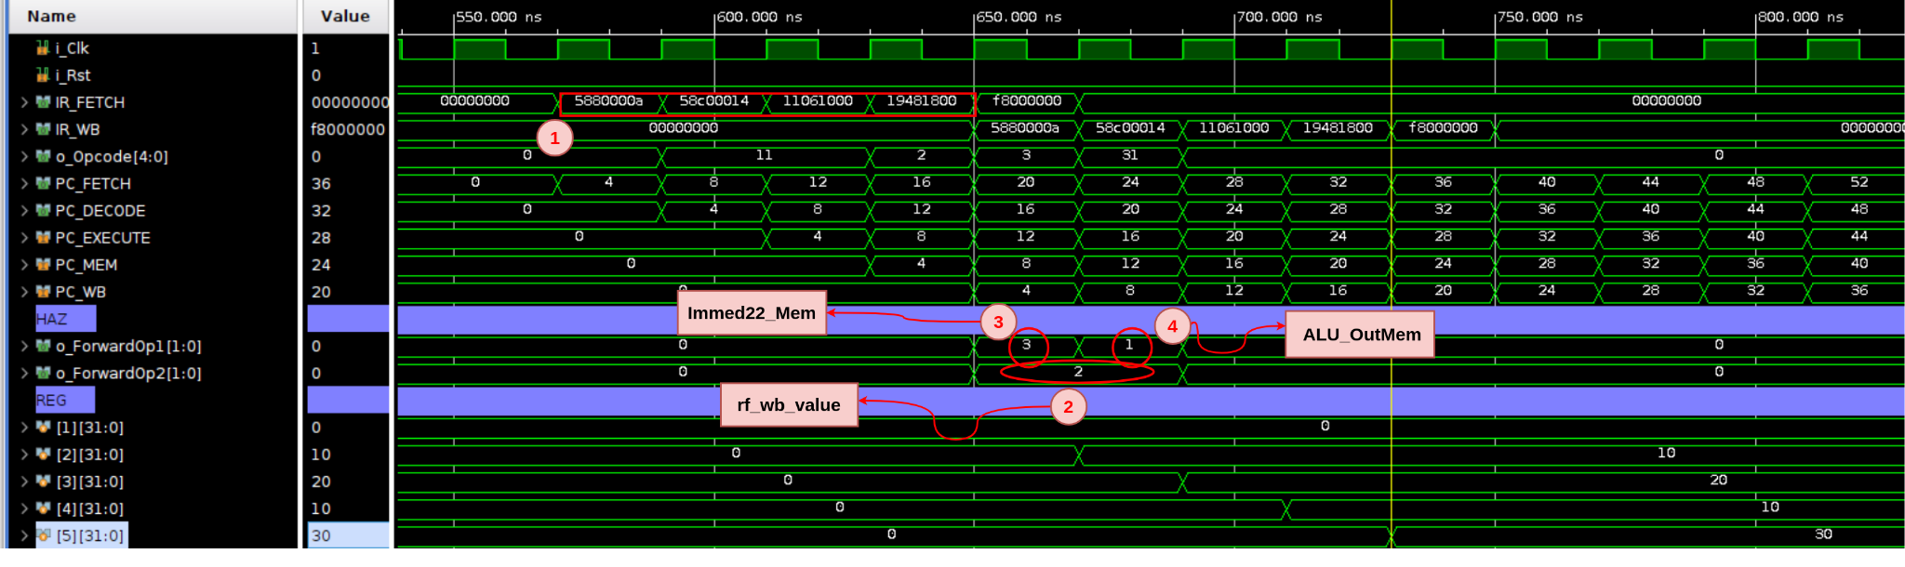
CPU Verification
Hazard Unit Integration
Forward Mechanism - Behavioral Simulation
2. SUB inst, 2nd OP = write-back stage of 1st LDI
3. SUB inst, 1st OP = immediate value from memory stage
4. OR inst, 1st OP = ALU output in the memory stage
Notes:
Roberto

Slide 33
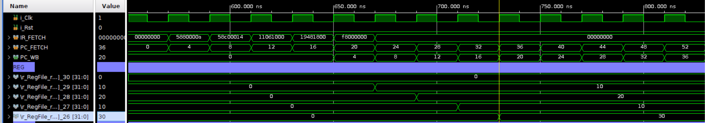
CPU Verification
Hazard Unit Integration
Forward Mechanism - Post-Synthesis Simulation
Notes:
Roberto

Slide 34
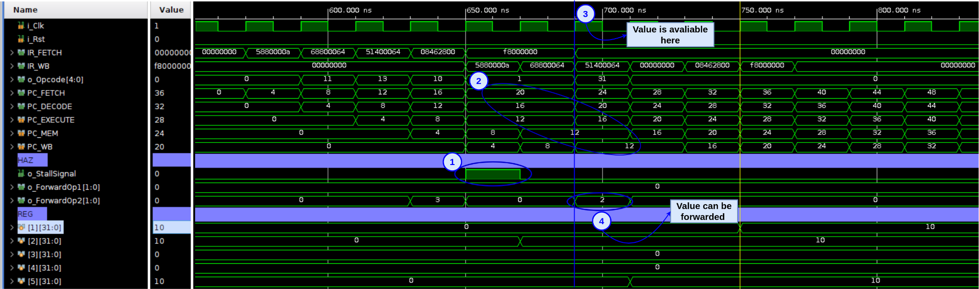
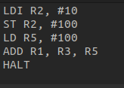
CPU Verification
Hazard Unit Integration
Stall Mechanism - Behavioral Simulation
NOP between LOAD and ADD
STALL mechanism
LOAD inst memory stage
value is forward
Notes:
Roberto

Slide 35
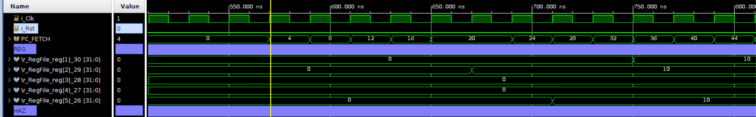
CPU Verification
Hazard Unit Integration
Stall Mechanism - Post-Synthesis Simulation
Notes:
Roberto

Slide 36
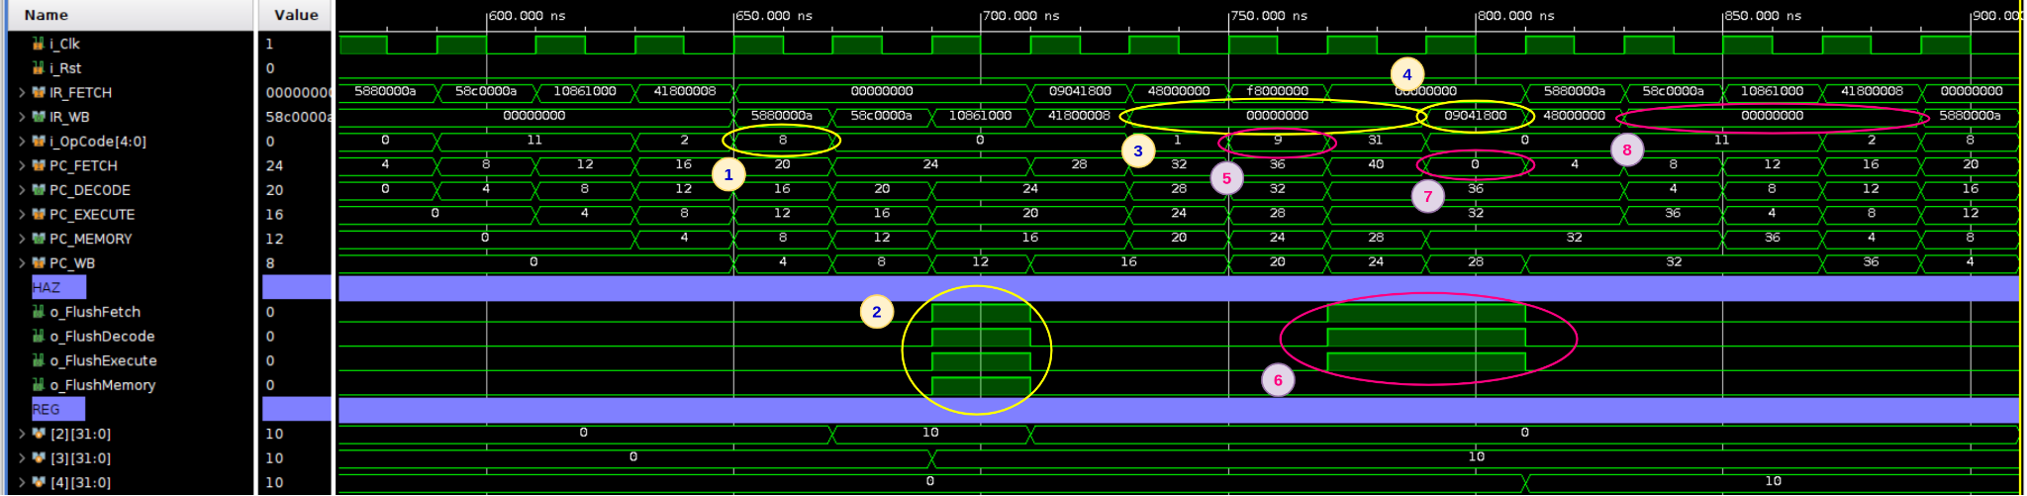
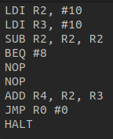
CPU Verification
Hazard Unit Integration
Flush Mechanism - Behavioral Simulation
branch instructions
jump instructions
Decode stage of the branch
Execute stage of the branch - flush signals
PC updated
ADD instruction being executed
Notes:
Roberto

Slide 37
CPU Verification
Hazard Unit Integration
Flush Mechanism - Behavioral Simulation
branch instructions
jump instructions
5. Decode stage of the JUMP instruction
6. Hazard unit send flush signals
7. PC updated
8. HALT instruction never executed
Notes:
Roberto

Slide 38
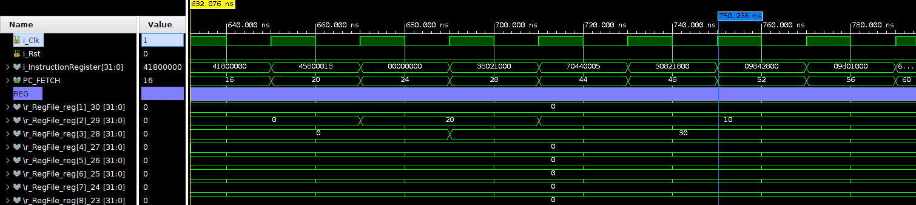
CPU Verification
Hazard Unit Integration
Flush Mechanism - Post-Synthesis Simulation
Notes:
Roberto

Slide 39
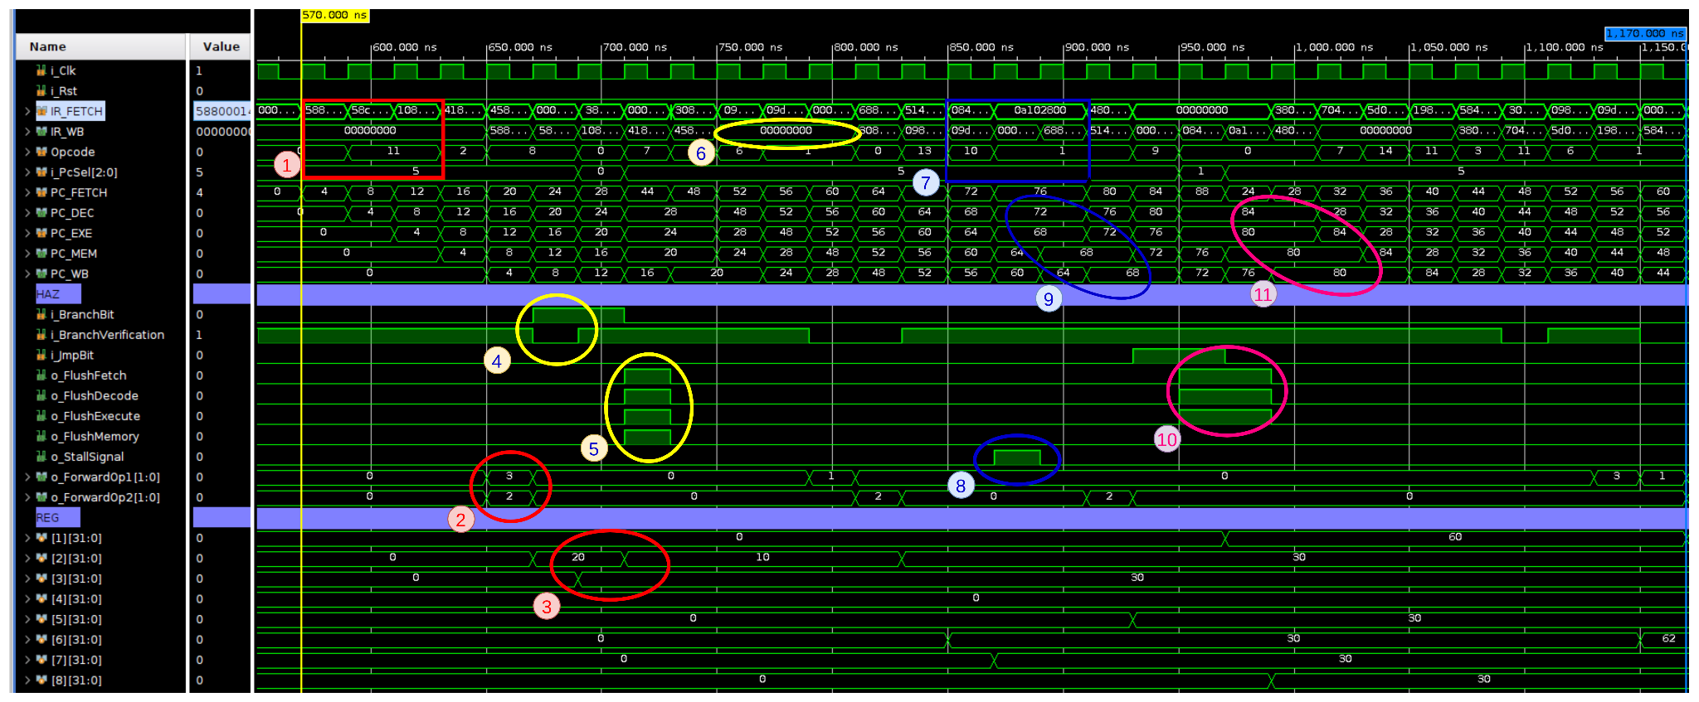
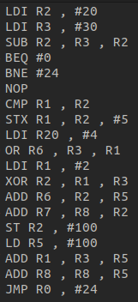
CPU Verification
Integration Test
execution of the LDI R2 and R3
forward mechanism
SUB instruction
Branch instruction, BranchBit = ‘1’
Flush Signals = ‘1’
IR are reset to ‘0’
Notes:
Roberto

Slide 40
CPU Verification
Integration Integration
7) ADD R6 and R7 (RAW)
8) Stall signal
9) Pause the pipeline
10) JMP, flush Fetch, Decode and Execute stages
11) Jump to correct PC
Notes:
Roberto

Slide 41
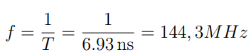
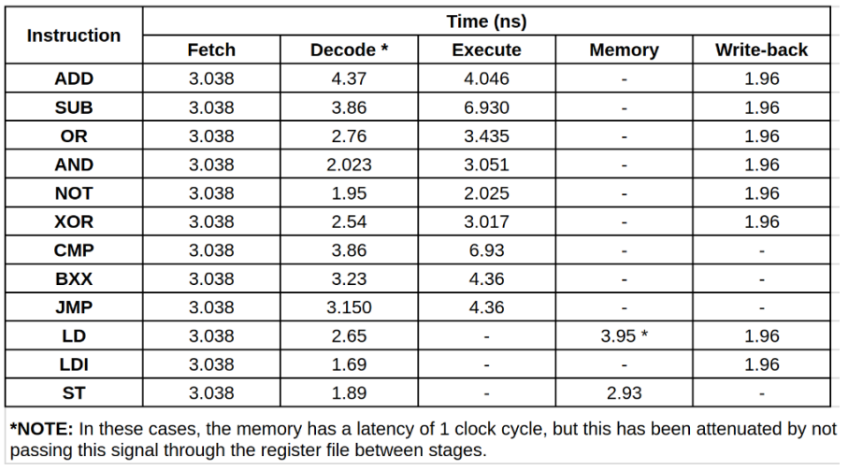
CPU Verification
Timings
Memory Stage (LD, ST, LDX and STX)
Write Back Stage
Timing Results
Last semester the maximum CPU frequency was 100 Mhz.
With the pipeline, it was possible to obtain a higher frequency due the stages division.
Notes:
Mário

Slide 42
PERIPHERALS

Slide 43
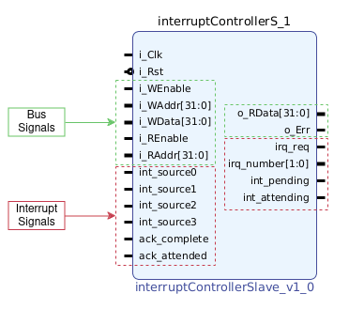
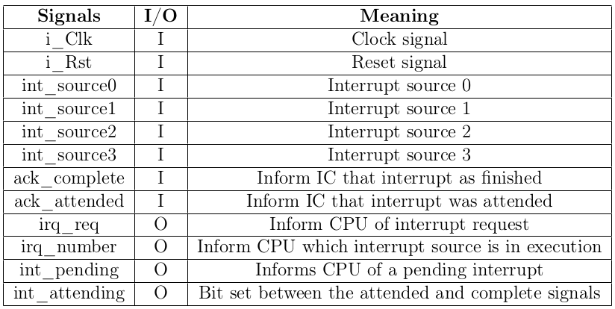
Interrupt Controller Design
Notes:
Alfredo

Slide 44
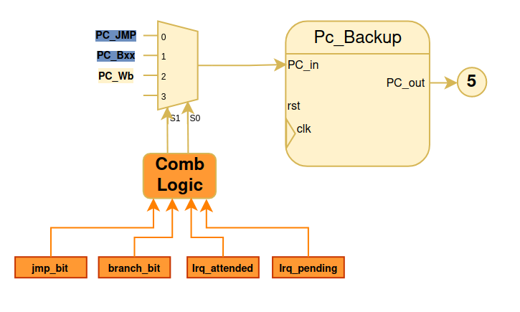
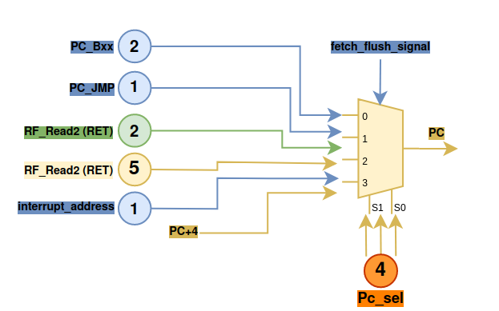
Interrupt Controller Design
Pending Interrupt
CPU modifications:
shadow register (PCBackup)
Fetch stage
Notes:
Alfredo

Slide 45


Interrupt Controller Design
Scenarios when an interrupt occurs:
When there is no control instruction in the current pipeline
Notes:
Alfredo

Slide 46


Interrupt Controller Design
Scenarios when an interrupt occurs:
When there is no control instruction in the current pipeline
Notes:
Alfredo

Slide 47


Interrupt Controller Design
Scenarios when an interrupt occurs:
When there is no control instruction in the current pipeline
Notes:
Alfredo

Slide 48


Interrupt Controller Design
Scenarios when an interrupt occurs:
2. When a control instruction is in the execute stage, and the jump is taken at that moment
Notes:
Alfredo

Slide 49



Interrupt Controller Design
Scenarios when an interrupt occurs:
3. A few clock cycles after a control instruction occurs
Notes:
Alfredo

Slide 50


Interrupt Controller
Implementation
Interrupt Source Activation
Interrupt Priority Determination
Notes:
Alfredo/Mário

Slide 51


Interrupt Controller
Implementation
An interrupt has been completed;
An interrupt has been attended;
A new interrupt request needs to be initiated;
Notes:
Alfredo / Mário

Slide 52

Interrupt Controller
Implementation
An interrupt is attended and there are no pending interrupts
An interrupt service routine has been completed and there are no pending interrupts
None of the above conditions is true.
Notes:
Alfredo /Mário

Slide 53

Interrupt Controller
Verification
Interrupt request during non-control instructions
Update the PC in the fetch stage;
PC_Backup has updated for another 2 clock cycles
1st RETI ignored
PC changed to value of the PC_Backup
Notes:
Alfredo / Mário

Slide 54

Interrupt Controller
Verification
2) Interrupt request when JMP/BXX is in execute stage
Notes:
Allfredo / Mário

Slide 55

Interrupt Controller
Verification
3) Interrupt request during the first 6 cycles after a JMP instruction
Notes:
Alfredo / Mário

Slide 56


GPIO
Implementation
Notes:
Zé

Slide 57

GPIO
Verification
Notes:
Zé

Slide 58
Interrupt Controller
&
GPIO
LIVE DEMO
Each interrupt turns on a LED
When a button is clicked, a interrupt triggers and switches on it’s respective LED
Notes:
Zé

Slide 59


Timer
Analysis and Design
Timer block diagram
Clock Divisor
Timer;
Clock Divisor
Divisor = 0: (no division);
Divisor = 1: (divide by 2);
Divisor = 2: (divide by 4);
Divisor = 3: (divide by 8);
Notes:
Zé

Slide 60

Timer
Implementation
Timer Configuration
Divisor (2-bit)
Mode
ChannelEnable (4-bit)
Auto-reload (1-bit)
Period (32-bit)
PulseChannel1-4 (8-bit)
OnePulseLenght (16-bit)
Enable (1-bit)
Notes:
Zé

Slide 61

Timer
Implementation
Clock Divisor
Notes:
Zé

Slide 62



Timer
Implementation
Timer mode
Notes:
Zé

Slide 63



Timer
Implementation
Counter mode
Notes:
Leal

Slide 64





Timer
Implementation
PWM mode
Notes:
Leal

Slide 65





Timer
Implementation
One Pulse mode
Ttillpulse
Tpulse
Notes:
Leal

Slide 66



Timer
Verification
PWM Mode - Behavioral Simulation
Notes:
Roberto

Slide 67

Timer
Verification
PWM Mode - Post-Synthesis Simulation
Notes:
Roberto

Slide 68

Timer
Verification
LIVE DEMO
Always the button is pressed, the Duty-Cycle increases in 10%
Notes:
Roberto

Slide 69


UART
BaudRate generator
Notes:
Mário

Slide 70


UART
Tx Module
Notes:
Mario

Slide 71


UART
Rx Module
Notes:
Mário

Slide 72


UART
Verification
Tx -
Right shifts the input
Rx
Left shifts the input
Notes:
Marcelo

Slide 73
UART
LIVE DEMO
The Computer sends data from UART
VeSPA Receives and processes it
VeSPA Transmit the received data back to the computer terminal
Notes:
Marcelo

Slide 74



PS/2 Keyboard Controller
Implementation
Notes:
Marcelo

Slide 75




PS/2 Keyboard Controller
Verification
Post-Synthesis simulation
PS/2 & UART Tx test
Notes:
Marcelo

Slide 76
PS/2 Keyboard Controller
UART
GPIO
LIVE DEMO
By pressing the number 4 in NumPad the Left LED will light up
By pressing the number 6 in NumPad the Right LED will light up
The pressed key will show up in UART
Notes:
Marcelo

Slide 77

VGA Analysis
VGA (Video Graphics Array) supports a variety of resolutions, ranging from 640x480 pixels to 1920x1200 pixels (we will only implement 640x480);
VGA uses 3 4-bit wide color signals: Red (R), Green (G), and Blue (B);
Horizontal sync signals indicate the beginning of each new scan line;
Vertical sync signals indicate the beginning of each new frame;
Notes:
Leal

Slide 78



VGA Design & Implementation
Notes:
Leal

Slide 79

VGA Implementation
VGA Clock
VGA Data
Notes:
Manel

Slide 80
VGA Implementation
VGA Clock
PLL to generate necessary clocks
Selects which clock should feed the rest of the peripheral
Redirects the selected clock to the rest of the peripheral
Notes:
Manel

Slide 81
VGA Implementation
VGA Data
Controls the output signals and border/active area generation based on the FSM
Gets and outputs the RGB values from a Video memory
Notes:
Manel

Slide 82


VGA Verification
Border generation:
Top and bottom borders + vertical sync
Left and right borders + horizontal sync
Notes:
Leal

Slide 83


VGA Verification
RGB Values:
Notes:
Leal

Slide 84
VGA
LIVE DEMO
When the bitstream is loaded onto the FPGA, a static image of our choice with a resolution of 640x480 (320x240 extended) at 60Hz will be displayed.
Notes:
Leal/Manel

Slide 85
Thank you for your attention !

